Slide 1
String is a sequence of characters, for e.g. “Hello” is a string of 5 characters.
In java, string is an immutable object which means it is constant and can cannot be changed once it has been created.

Slide 2
There are two ways to create a String object:
By string literal :
Java String literal is created by using double quotes.
For Example: String s=“Welcome”;
By new keyword :
Java String is created by using a keyword “new”.
For example: String s=new String(“Welcome”);

Slide 3
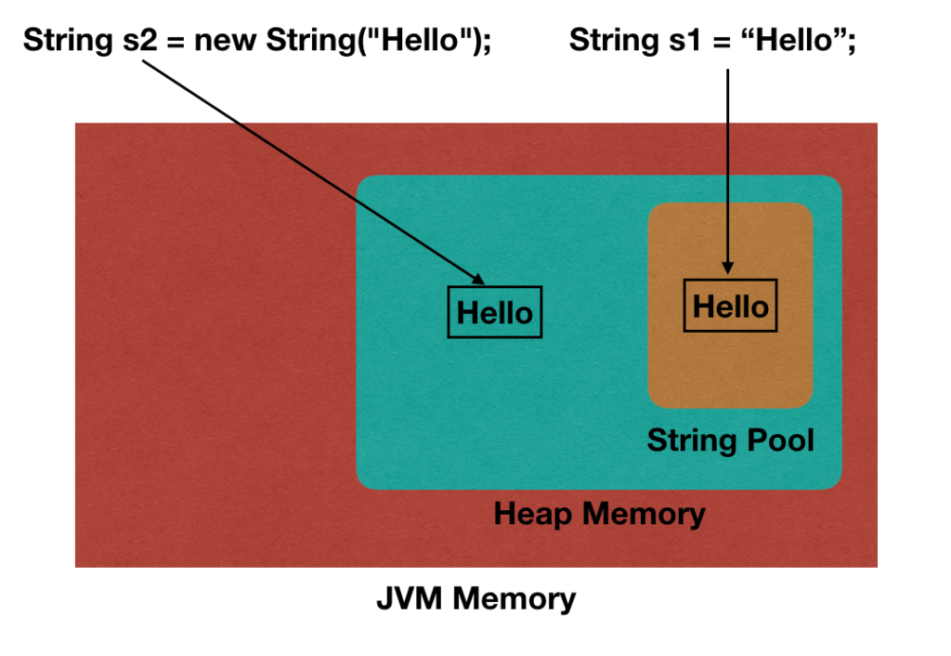

Slide 4
Java String POOL
How Does Java String Pool Works?
When we create a string literal, it’s stored in the string pool.
If there is already a string with the same value in the string pool, then new string object is not created.
The reference to the existing string object is returned.
Java String Pool is a cache of string objects. It’s possible because string is immutable.
If we create a string object using new operator, it’s created in the heap area.

Slide 5
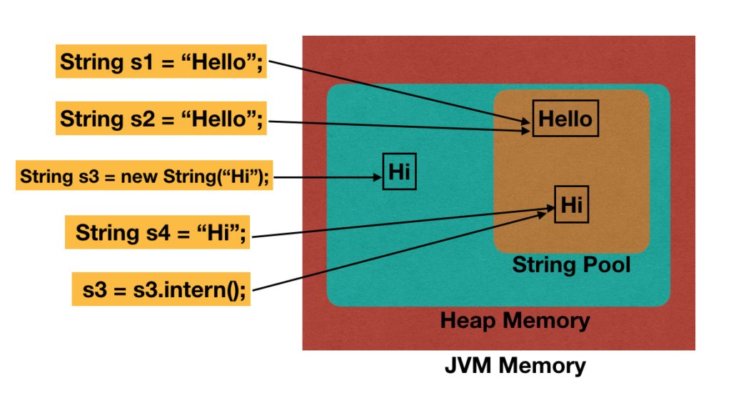
Understanding String Pool With a Program

Slide 6
Understanding String Pool With a Program
public class JavaStringPool {
public static void main(String[] args) {
String s1 = "Hello";
String s2 = "Hello";
String s3 = new String("Hi");
String s4 = "Hi";
System.out.println("s1 == s2? " + (s1 == s2));
System.out.println("s3 == s4? " + (s3 == s4));
s3 = s3.intern();
System.out.println("s3 == s4? " + (s3 == s4));
}
}

Slide 7
StringBuffer
What is StringBuffer in Java?
StringBuffer class is used to make String objects mutable. Therefore, those objects can be modified. StringBuffer defines four constructors. StringBuffer(), StringBuffer(int size), StringBuffer(String str), StringBuffer (charSequence [] ch)
Refer the code below,
StringBuffer s1= new StringBuffer(“Hello”);
s1.append(“World”);
System.out.println(s1);
In statement 1, s1 is referring to the “Hello” object in a heap. The object is mutable because it is created using StringBuffer. In statement 2, “World” is appended to the same “Hello” String object.
String objects created with StringBuffer class can save memory. StringBuffer provides thread safety because two threads cannot access the same method in the StringBuffer class simultaneously.

Slide 8
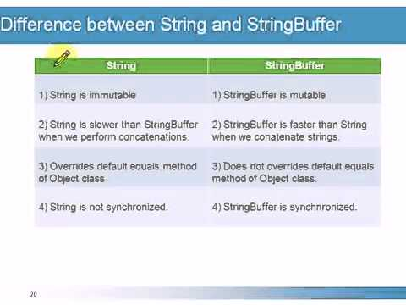
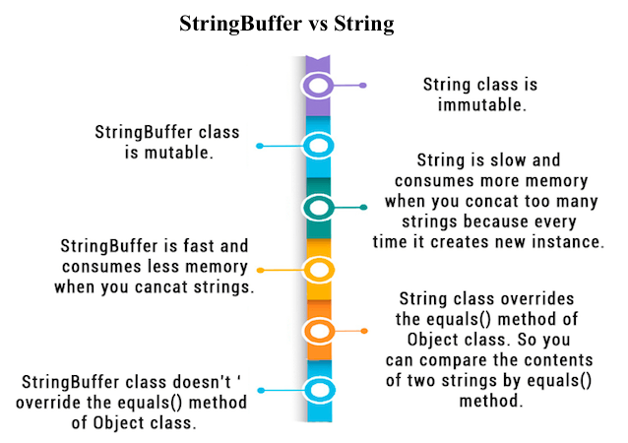
String Vs StringBuffer

